Slide 1
Enabling IPsec via P4Runtime and OpenConfig
By Arun Acharya & Sabeel Ansari
Intel Corp

Slide 2
IPsec over P4
IPsec secures the data traffic at IP layer. It is becoming a common practice to use a secure tunnel for data transfer.
Most of the IPsec implementation on accelerators are fixed function blocks which applies IPsec directly on packets if enabled.
RFC 4301 defines policy-based IPsec enablement with security policy database(SPD) and security association database(SAD).
Here we are proposing a P4-based programmable IPsec flows with security policy database and non P4-based security association database.

Slide 3
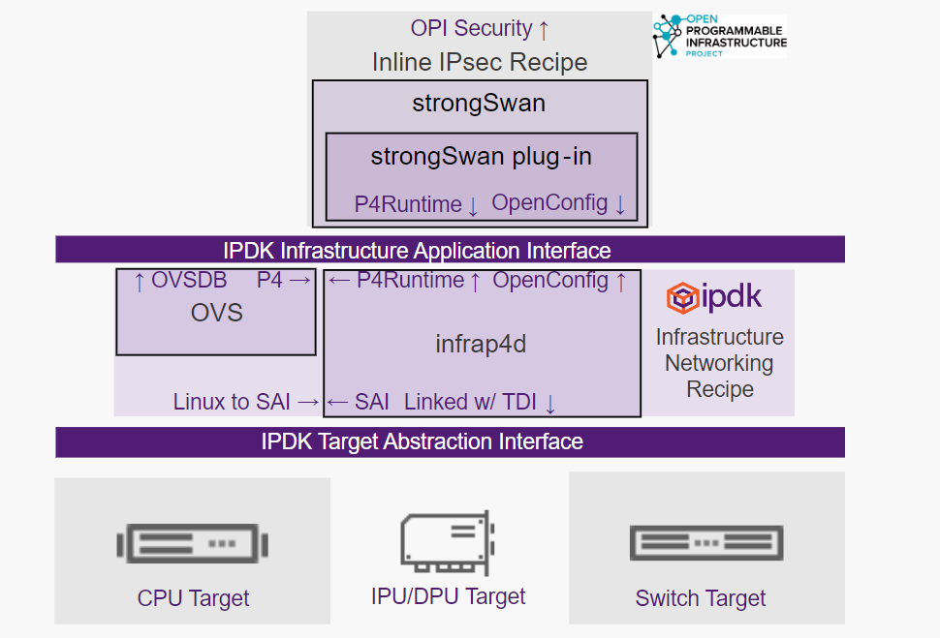
Table Driven Interface (TDI)
Table Driven Interface (TDI) is a Target Agnostic Interface, present under opensource p4lang/tdi.
IPsec SPD & SAD classification tables are configured through P4 based TDI tables.
Every configuration entity is represented as P4(e.g MatchActionDirect) or non-P4 (Port, IPsec SAD configuration) tables.
These tables can be configured from p4RT and OC gnmi clients.

Slide 4
SPD & SAD
The IPsec data plane programming is separated into 2 parts.
P4 Tables compiled from the Inline IPsec P4 program.
Control blocks for Tunnel and Transport modes.
Parser support for IPsec ESP
Modify logic to encapsulate on the outer and inner headers of the packet.
IPsec OpenConfig schema based on the RFC
Configuration of the type & strength of encryption
Encryption keys w/ mechanisms to re-key
Authentication & Re-authentication mechanisms
Classification
Access Control Lists
Designed to stay aligned with the OPI Security API specification

Slide 5
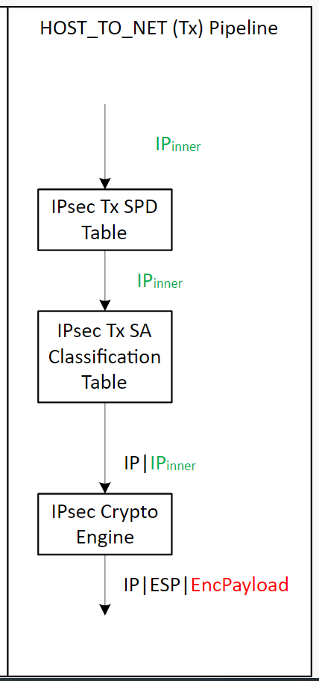
IPSec Tunnel Mode TDI API Tables (HOST_TO_NET Tx Direction)
Step | IPSec Table | P4 & Fixed Function | TDI Table for Config
​1 | ​IPsec Tx SPD Table (RFC2401 4.4.1 SPD) | P4 Match Action Table​ Key: Exact, LPM, Ternary fields Actions: Set packet metadata (CRYPTO_OFFLOAD) | MatchActionDirect Table P4 Key fields: Exact, LPM, Ternary fields P4 Action: P4 action for protect P4 action for bypass Data: None
2 | IPsec Tx SA Classification Table (RFC2401 4.4.2 Selectors) | P4 Match Action Table Key: Exact, LPM, Ternary fields Action: Set packet metadata (SA INDEX) Encapsulate tunnel IPV4 & Eth header | MatchActionDirect Table P4 Key fields: Exact, LPM, Ternary fields P4 Action: P4 action for setting SA Index P4 action for bypass Data: SA Index value MatchActionDirect Table (for encap header data) P4 Key fields: MOD data pointer P4 Action: P4 action for encapsulate tunnel header Data: Tunnel IPV4 & Eth header fields (S-IP, D-IP, S-MAC, D-MAC, ..)
3 | IPsec Crypto Engine (RFC2401 4.4.3 SAD) | Fixed Function Key: SA Index Action: Insert ESP header and encrypt payload w/ SA fields | IPSec SAD Table Fixed Key fields: SA Index Fixed Action: HW fixed action to insert ESP header and encrypt & authenticate payload Data: Crypto_Tag, IPSec protocol, SPI, key, algorithm, IV, lifetime, …

Slide 6
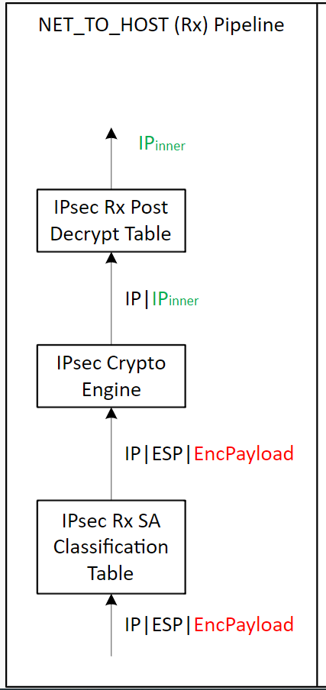
IPSec Tunnel Mode TDI API Tables (NET_TO_HOST Rx Direction)
Step | Table | P4 & Fixed Function | TDI Table for Config
​1 | IPsec Rx SA Classification Table​ (RFC2401 4.4.3 SAD) | P4 Match Action Table Key: Exact header fields + SPI Action: Set packet metadata (SA INDEX) | MatchActionDirect Table P4 Key fields: Exact match header + SPI fields P4 Action: P4 action to set packet metadata P4 action for bypass Data: SA INDEX
2 | IPsec Crypto Engine (RFC2401 4.4.3 SAD) | Fixed Function Key: SA Index Action: Remove ESP header and decrypt & authenticate payload Set metadata (crypto_status, crypto_tag) | IPSec SAD Table Fixed Key fields: SA Index Fixed Action: HW fixed action to remove ESP header and decrypt & authenticate payload.. Data: Crypto_Tag, IPSec protocol, SPI, key, algorithm, IV, lifetime, anti-replay window
3 | IPsec Rx Post Decrypt Table (RFC2401 4.4.1 SPD) | P4 Match Action Table Key: Exact match on Crypto_tag Action: Decapsulation of tunnel IPV4 & Eth header | MatchActionDirect Table P4 Key fields: Exact match on crypto_tag P4 Action: P4 action for decapsulate tunnel IPV4 & Eth header (tunnel mode) P4 action for bypass (transport mode) Data: None

